Slide 1

Final Year Project Presentation on
“KeyDash”
Affiliated to Pokhara University
POKHARA ENGINEERING COLLEGE
Phirke, Pokhara-8
Supervised By:
Er. Shiva Kunwar
Presented By:
Britant Shrestha(22070449)
Manish Shrestha(22070452)
Ranjana Dhakal(22070457)
Rijan Shrestha(22070458)

Slide 2
INTRODUCTION
      KeyDash is a web-based application for measuring typing speed and accuracy in real time.
      In today’s digital age, typing speed and accuracy are essentials skills for students, professionals, and casual users alike.

Slide 3
PROBLEM STATEMENT
Many fail to provide real-time feedback on essential performance metrics such as word per minute(WPM), typing accuracy, and error counts.
While typing is a fundamental digital skill in today’s digital world, existing typing practice solutions suffer from critical limitations and outdated design.
There is also limited support for diverse typing modes, such as Symbols typing and Custom typing, which are crucial for varied practice.

Slide 4
OBJECTIVES
The primary objectives are:
Provide a multi-mode typing: Language, Coding, Symbol, Custom text
Implement Multiplayer and Battle with AI mode
Gamify user experience

Slide 5
LITERATURE REVIEW
Current platforms like 10FastFingers and TypingClub provide basic WPM and accuracy tests but lack customization, multi-language support, and detailed progress tracking.
Traditional typing practice methods are often unsystematic and do not offer real-time feedback, personalized analytics, or long-term performance monitoring.
KeyDash bridges these gaps by offering customizable tests, multiple language input, real-time analytics, and user progress tracking through Supabase — all in an accessible, user-friendly web interface.

Slide 6
PROJECT SCOPE
KeyDash provides real-time typing tests in nulti-modes to calculate accuracy, speed(WPM), and errors with comprehensive analytics and performance history. It also monitor user progress.
Through competitive leaderboards, KeyDash encourage users to compare their performance globally or with friends, enhancing motivation and engagement.

Slide 7
TECHNICAL STACK
React.js, TailwindCSS
Framer Motion
Supabase
PostgreSQL
Git and Github
Vercel

Slide 8
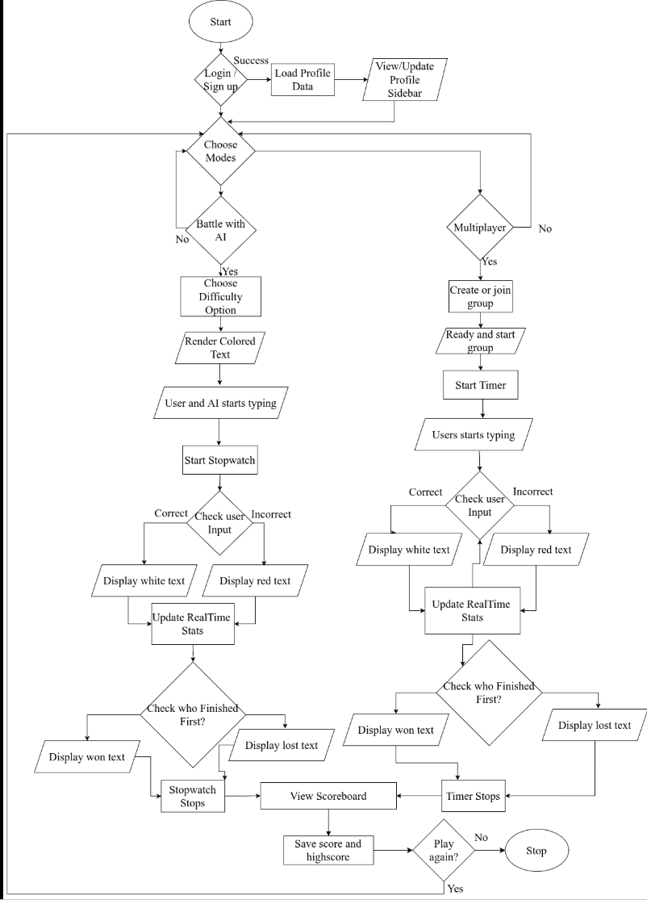
METHODOLOGY

Slide 9
TEST CASES
S.N. | Test Case Summary | Results
1 | To test whether it displays differently to incorrect character. | Passed
2 | To Restart the dashboard for next display text | Passed
3 | To test whether it displays score, graph and leaderboard. | Passed
4 | To Verify real-time synchronization in multiplayer races. | Passed
5 | To Verify multi-language switch (Nepali/English) | Passed
6 | To test whether it keeps the record of the user progress or not. | Passed
7 | Test AI opponent behavior at different difficulty levels. | Passed
We want our system to provide detailed performance analytics (speed, accuracy, error patterns) in real-time to help user improve.
Our goal is to enable progress tracking with saved history and personalized insights.

Slide 10
CONCLUSION
KeyDash is a simple and user-friendly typing tester that measures and improves typing speed with real-time results. Built with React.js and Supabase, it is responsive, secure, and easy to use.
Overall, KeyDash fulfills the core objective of providing Multi-mode with multiplayer support and Battle with AI mode.

Slide 11
REFERENCES
D. H. Smith and J. A. Doe, "The Impact of Real-Time Feedback onTyping Proficiency," Journal of Computer-Assisted Learning, vol. 12, no.3, pp. 45–60, 2020.
TypingClub, "Gamified Learning in Typing Education," EdTechReview, 2022. [Online]. Available: https://www.typingclub.com/research
10FastFingers, "Typing Speed Test Methodology," 2019. [Online].Available: https://www.10fastfingers.com/methodology
[5] A. Taylor et al., "Engagement in Digital Typing Tutors: A Meta-Analysis," Computers & Education, vol. 95, pp. 89–102, 2021.

Slide 12
THANK YOU!!

